Slide 1
Sinkhole
2 Men - 1 Chasm
Daniel Yan and Kyle Lotterer

Slide 2
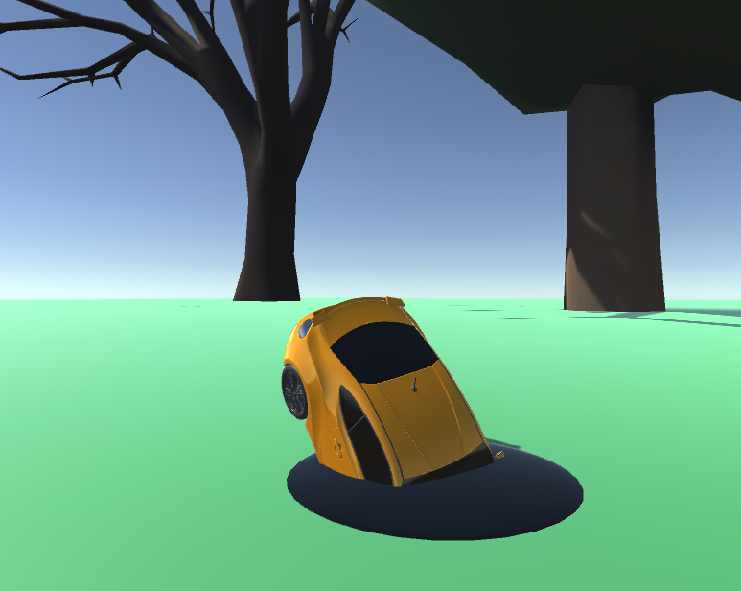
Project Overview
VR Game of of a sinkhole
Gameplay
User moves a sinkhole around, causing objects to fall inside
Sinkhole will change in size from objects falling inside
A timer and point system will be present with points given on sinkhole size
Proposal
Initial Proposal Image

Slide 3
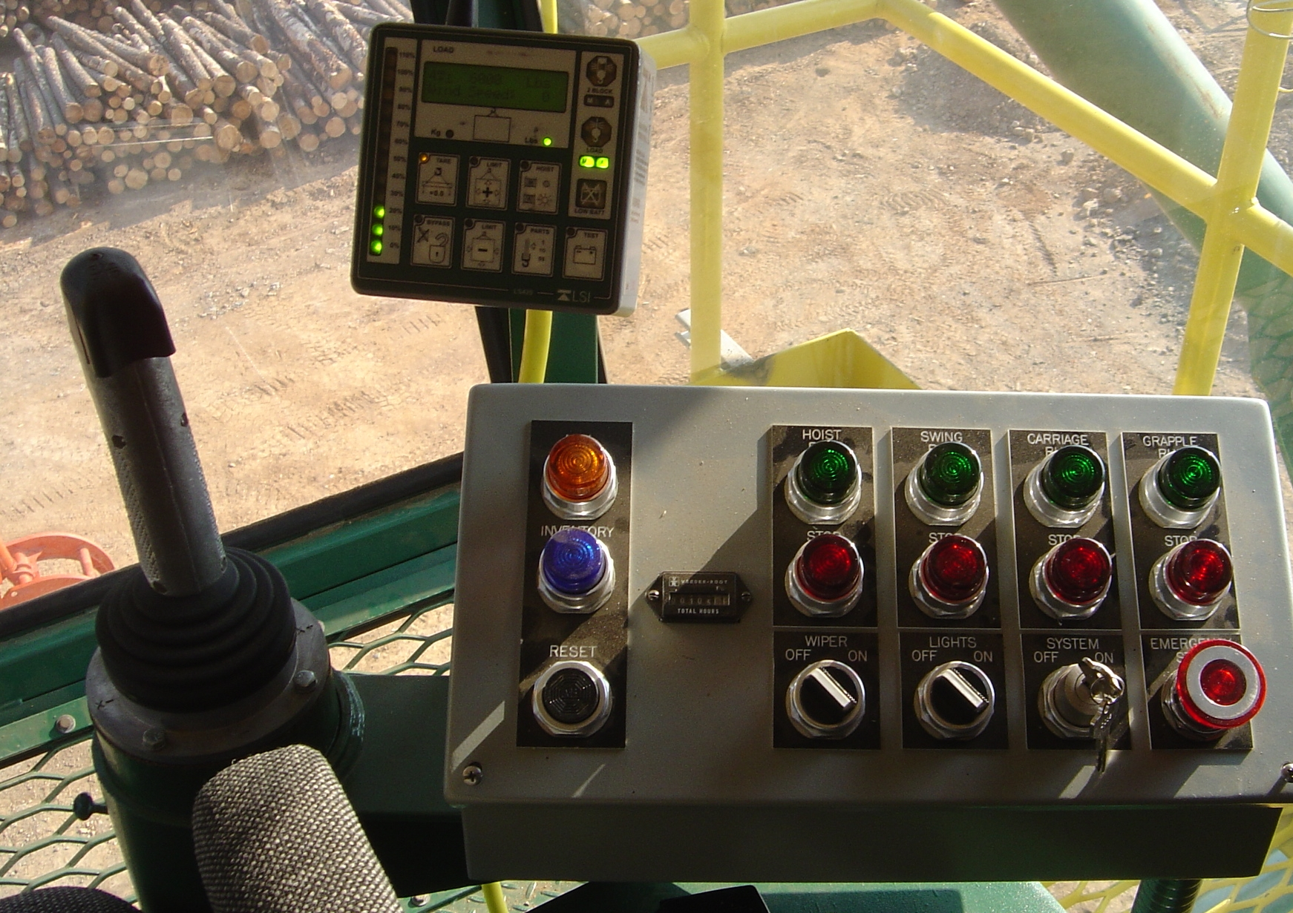
Original Gameplay Details
Project will be in VR for the HTC Vive
User will move around a “sinkhole” using VR controls
As objects move under the sinkhole, they will fall inside
The more objects that fall inside, the bigger the hole
The objective is to get as many objects in the hole before a time limit
Time: 1:27
Points: 30
Initial User View Control Box

Slide 4
Core Features
Creating a sinkhole where objects can fall through in VR with HTC Vive
Allow sinkhole movement through a user controller
Changing the sinkhole size based on the objects
Adding a time limit and a point system based on objects in the sinkhole

Slide 5
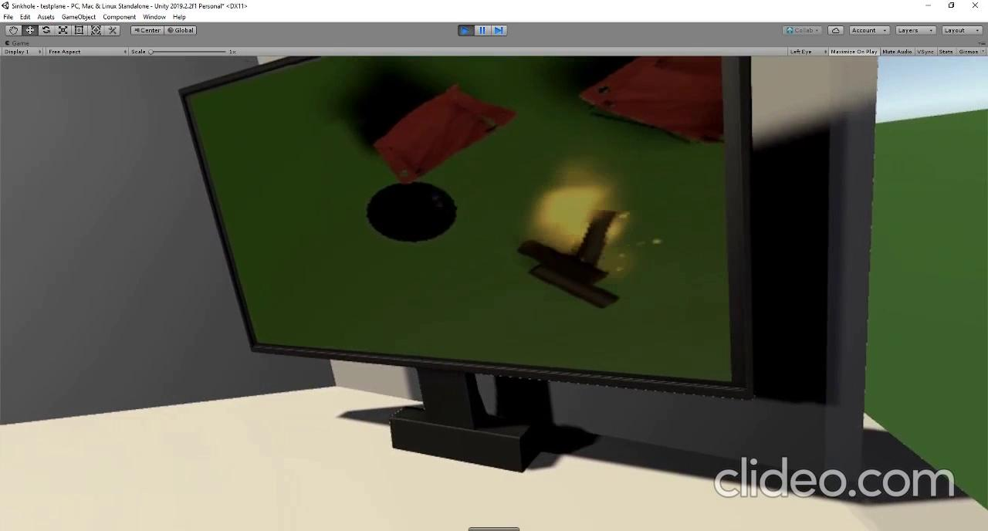
Video of Current Progress

Slide 6
Features added
Multiple camera viewports
1 as VR eye camera, another as aerial view placed as a texture
Sinkhole interaction
Upon consuming an item the sinkhole will grow
Environmental Assets
Items of different sizes with realistic physics can be swallowed by the sinkhole
User Control
User is able to use HTC Vive’s controller to control the sinkhole
Core Features 1, 2, 3

Slide 7
Features to do
Fix SceneNode joystick
Finish light diffusion
May be done as a skybox light or environmental lighting
Game scoring?
Point scoring based on items that are consumed by the sinkhole
Game condition?
Timer which limits the user on the amount of items to consume
Potential Features (stretch goals)
Environmental hazards
Winds
‘Power-ups’ affecting sinkhole
Size, movement speed, suck ability

Slide 8
Revamped Schedule
12/4/2019 | Demo in progress Core Features 1, 2, 3 are completed on a basic level
12/6/2019 | Scene node hierarchy is completed. Light diffusement is added and tested. Basic controls, level and mechanics are refined and tested
12/8/2019 | Core Feature 4 for game elements of time and point scoring is tested and completed.
12/9/2019 | Final demo of Sinkhole + additional testing if necessary
11/15/2019 | Basic scene setup
11/18/2019
11/21/2019 | Basic VR controls set up
11/23/2019 | Hole/object interaction complete
11/25/2019 | Demo
12/2/2019
12/5/2019
12/7/2019 | Project complete with extra 2 days for minor bugfixing

Slide 9
Questions?
Suggestions / Comments?
11/15/2019 | Basic scene setup
11/18/2019
11/21/2019 | Basic VR controls set up
11/23/2019 | Hole/object interaction complete
11/25/2019 | Demo
12/2/2019
12/5/2019
12/7/2019 | Project complete with extra 2 days for minor bugfixing

